Slide 1
BookBugs Book Review App
Final Project- Smartphone Based Web Development
Ankit Yadav
NUID- 001271369
College of Engineering
Northeastern University
Boston, MA

Slide 2
Introduction
This is book review app which will let user to search books by title, view their information, give reviews and view reviews given by others.
Feautures:
Used Goodreads API to fetch the data of the books.
Used Firebase Authentication email and password based authentication
Used Firebase GoogleSignIn feature to let user signin by using google
Used Firebase Database to save User data and all the Reviews created.
Used AutoLayout for layout positioning and UI

Slide 3
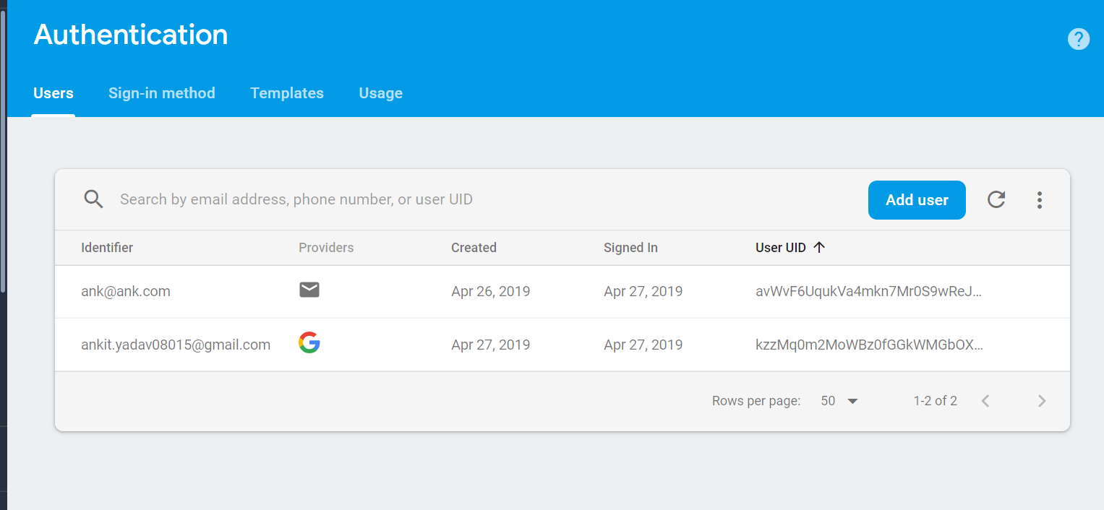
Firebase Authentication
Firebase auth screen

Slide 4
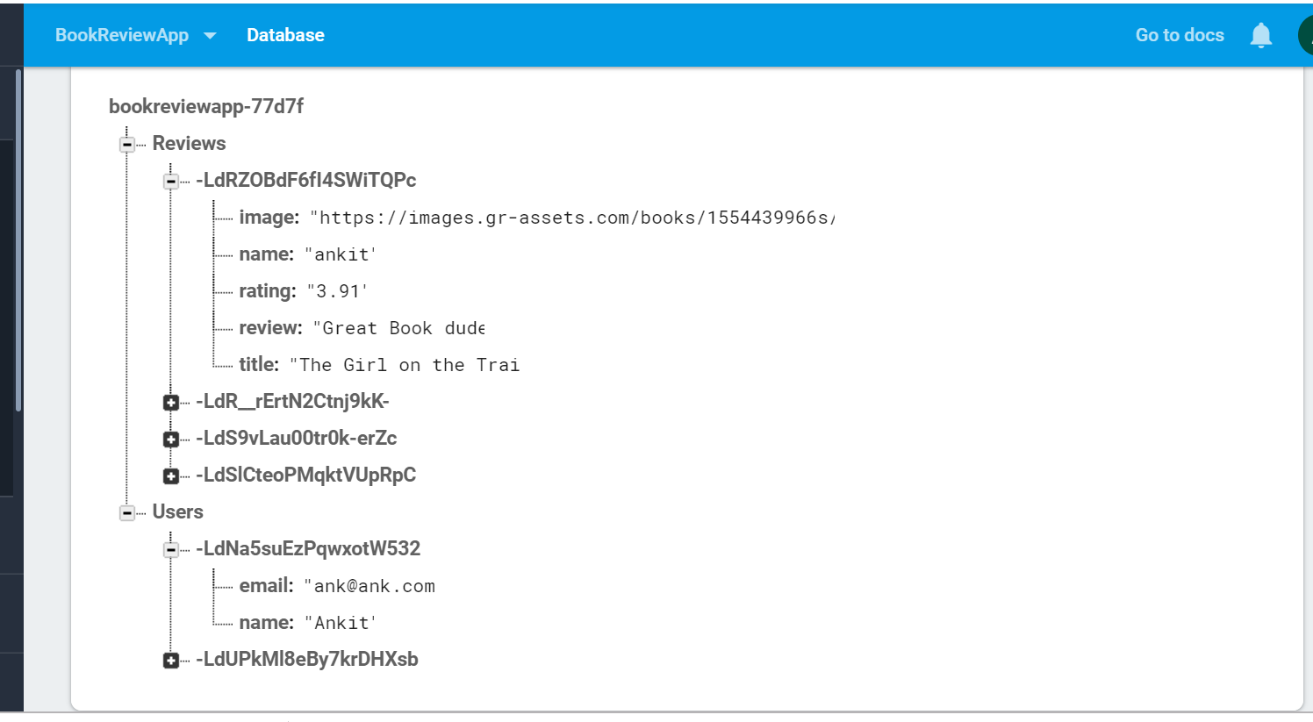
Firebase Database
Firebase database to save user data and reviews

Slide 5
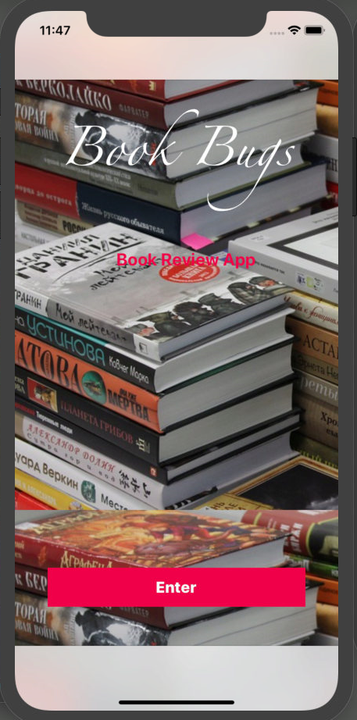
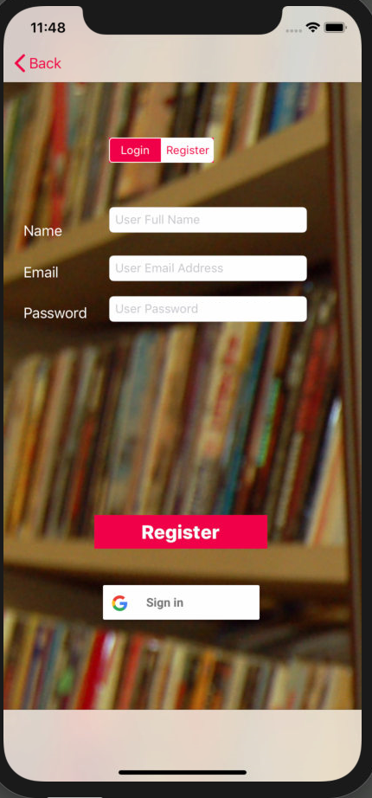
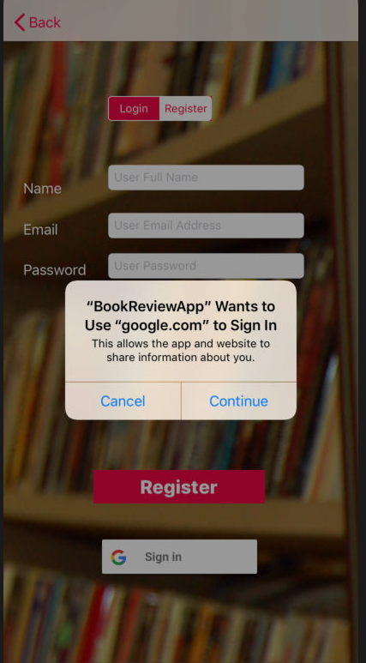
Login Page
Home Page and Login/Register

Slide 6
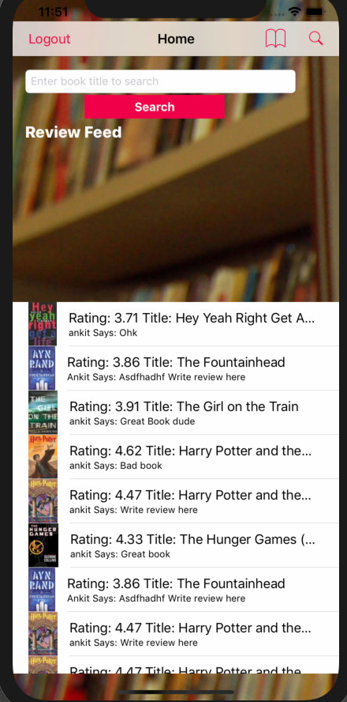
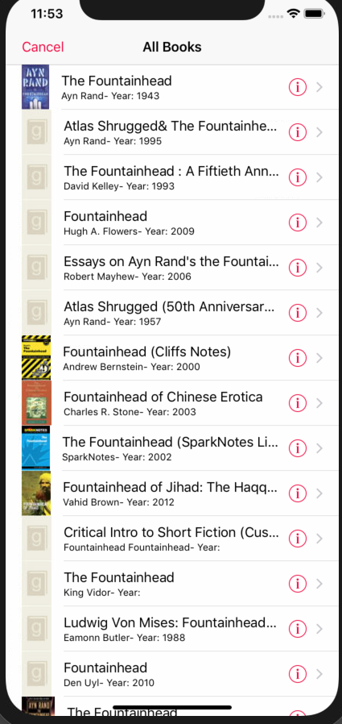
Home Page
Home page with search box and search bar. Search result page on searching

Slide 7
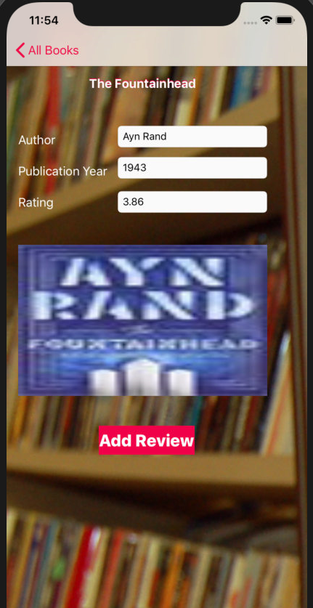
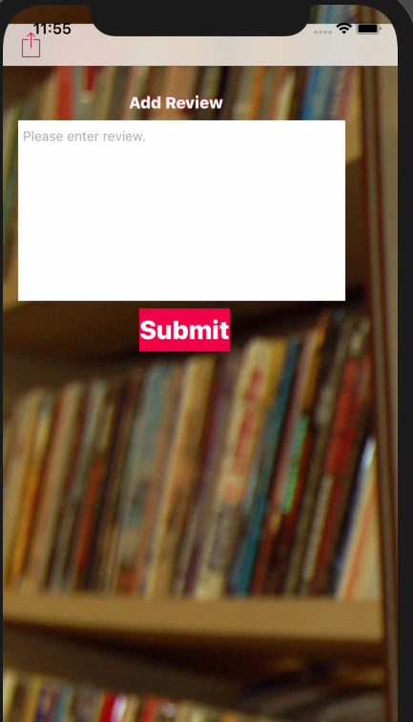
Book Page
Book info page. User can go to add review page and add the review

Slide 8
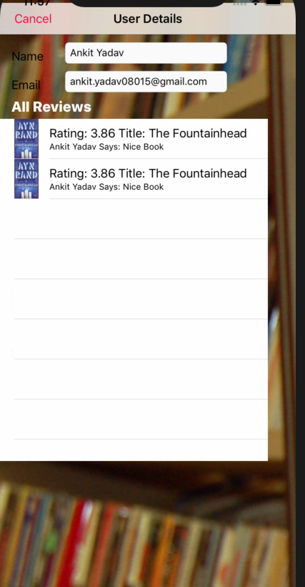
User Detail
User detail page to view user’s information and all the reviews done by them

Slide 9
Thank You

